Slide 1

Capstone 2
Response and Demo to InformatiTEK’s RFP
Presented by: Noah Evans
March 31st , 2022

Slide 2
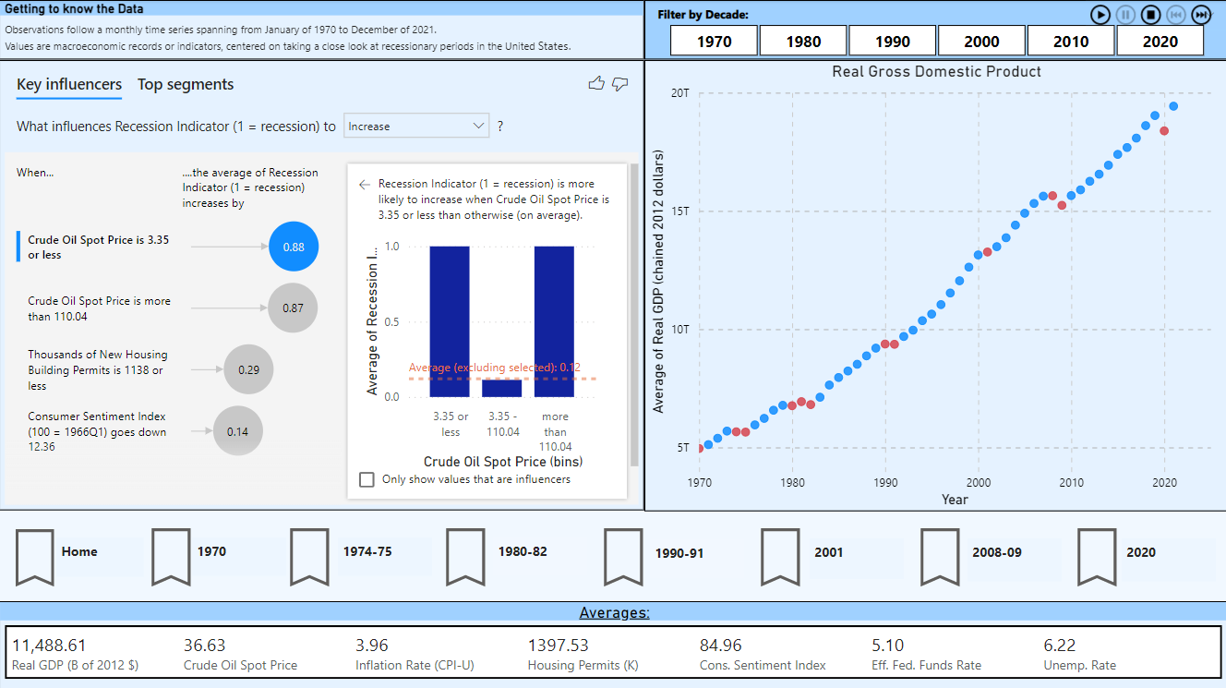
Introduction
Utilized a dataset comprised of macroeconomic indicators of the past 50 years, focused on recessions
Created a Power BI dashboard featuring:
Main dashboard covering the dataset overall
Two reports diving deep in two periods identified
One report testing a recent economic topic
Developed a machine learning algorithm to predict recessionary periods
Quality testing
Conducted linear regression for further statistical insights

Slide 3
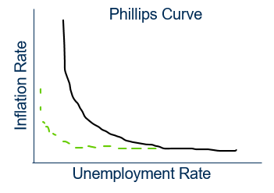
Defining Aspects of the Data Set
Monthly, time-series spanning from 1970-2021, covering macroeconomic indicators, with an emphasis on recessions
How I arrived at the data set:
Effective Federal Funds–Overnight bank-to-bank interest rates on loans, determined in the market for excess reserves
Consumer Sentiment Index–Survey conducted by U-Mich, asking questions on how consumers feel about the prospects of the economy
Real GDP–Dollar value of the sum of goods and services produced in an economy
Phillips Curve–Hypothesized inverse relationship between unemployment and inflation

Slide 4
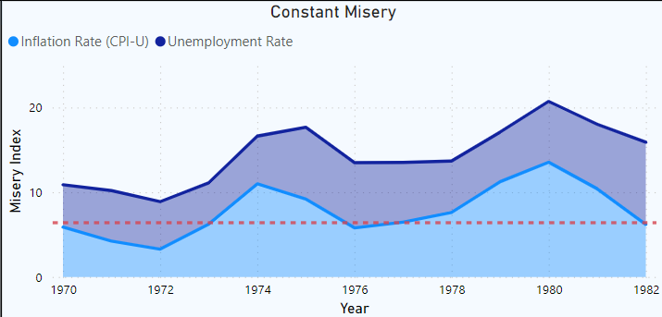
Dashboard
Key Values
Watch the data shift over time through the use of:
Power BI Plug-in
Filters (slicers)
Chart-to-chart interactivity
Dynamic comparison chart
Adding constant lines for significant macroeconomic events or macroeconomic benchmarks for comparison
Focus on relevant events
Bookmarked views

Slide 5
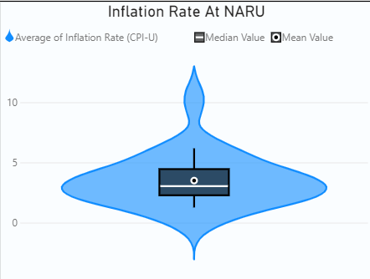
Dashboard
NARU – Estimated natural range of unemployment where deviations in unemployment do not result in major changes to inflation
Stretch Functionality
Incorporated Power BI plug-in for violin charts
Used violin charts and DAX calculations to visualize and test a recent hypothesis surrounding the relevance to the Phillips Curve in modern economic times
“Has the Phillips Curve flattened?”
This can be assessed:
Visually
Fundamentally with the information it provides on variation

Slide 6
Dashboard:
Demo

Slide 7
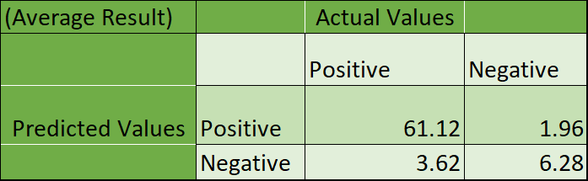
Machine Learning Algorithm
Utilized logistic regression to create an algorithm, where:
Unemployment rate, fed funds rate, price of oil, consumer sentiment, new housing building permits
Have been inputted to determine if a given period resulted in a recession
Random split of 35% of the 208 quarters dedicated to assessing the accuracy of the algorithm (test set)
Quality assurance testing conducted to get an accurate and reliable measure of the algorithm’s capacity and results
Total Accuracy of 92.4%

Slide 8
Linear Regression for Statistical Analysis
Utilized linear regression to create a model, where:
Unemployment rate, fed funds rate, price of oil, consumer sentiment, new housing building permits
Have been inputted to model Real GDP
A “flavor” of the Chow test was done on the model to determine if the model was stable across recessionary periods
Passing the Chow test entails that the model is stable across recessionary periods
Failing the Chow entails the model is not stable across recessionary periods

Slide 9
Linear Regression Results
 | Expansionary | Recessionary
Unemployment Rate | -0.5328 | -0.2854
Fed. Funds Rate | -0.1193 | -0.1817
Oil Price | 0.2848 | 0.2948
Consumer Sentiment | 0.4251 | 0.5078
Housing Permits | 0.1017 | 0.1500
Failed the Chow test
Interestingly means that the independent variables had statistically different effects on Real GDP in recessionary periods compared to expansionary (non-recessionary) periods
Two separate regressions (one for expansionary periods and one for recessionary periods) were necessary to get proper outputs
Both models and their respective coefficients were statistically significant
R² for expansionary model was 92.6% and 98.3% for the recessionary model
“A one percent increase to (independent variable) will result in a (coefficient) percent change in GDP”

Slide 10
Sources
Federal Reserve. (2017, March 16). Federal Reserve interest rates, 1954-present. Kaggle. Retrieved March 31, 2022, from https://www.kaggle.com/datasets/federalreserve/interest-rates/metadata
Federal Reserve Bank of St. Louis. (n.d.). Federal Reserve Economic Data: Fred: St. Louis Fed. FRED. Retrieved March 31, 2022, from https://fred.stlouisfed.org/

Slide 11
Q&A
Questions?

